Slide 1
Irradiance Meter
Alex Polyanskiy
Montana State University
Bozeman, MT

Slide 2
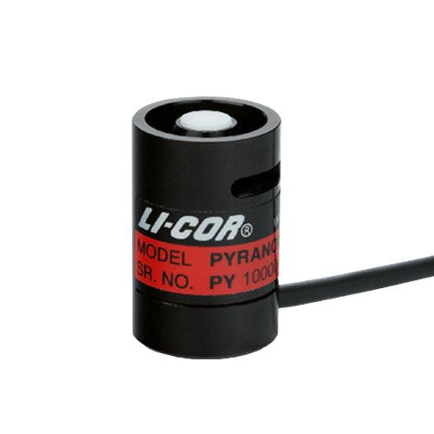
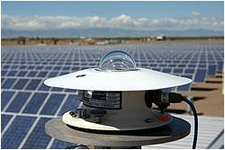
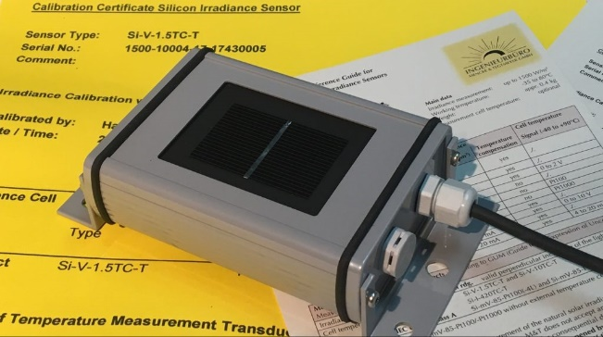
Measuring Solar Irradiance
Solar Irradiance is radiant flux (power) per unit area ($\frac{W}{m^{2}}$) received from the sun
A pyranometer measure global irradiance (direct + diffused)
Thermopile | Photodiode | Reference Cell
Flat Spectral Response Highest Accuracy Most Expensive Not used in handheld meters | Spectrally Selective, not what a panel sees Least Accurate Least Expensive Requires angle correction | Closely matches PV panel spectral response Accurate to PV Panels Cost depends on the Cell Calibration Sees what a solar panel sees
2

Slide 3

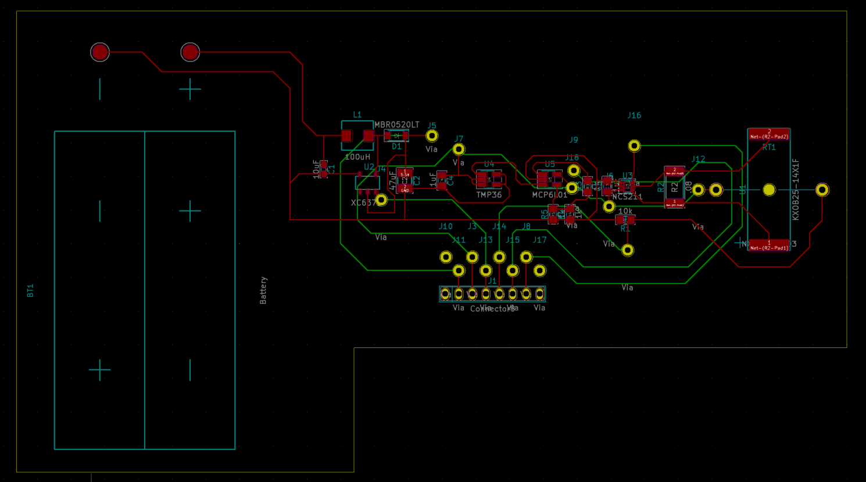

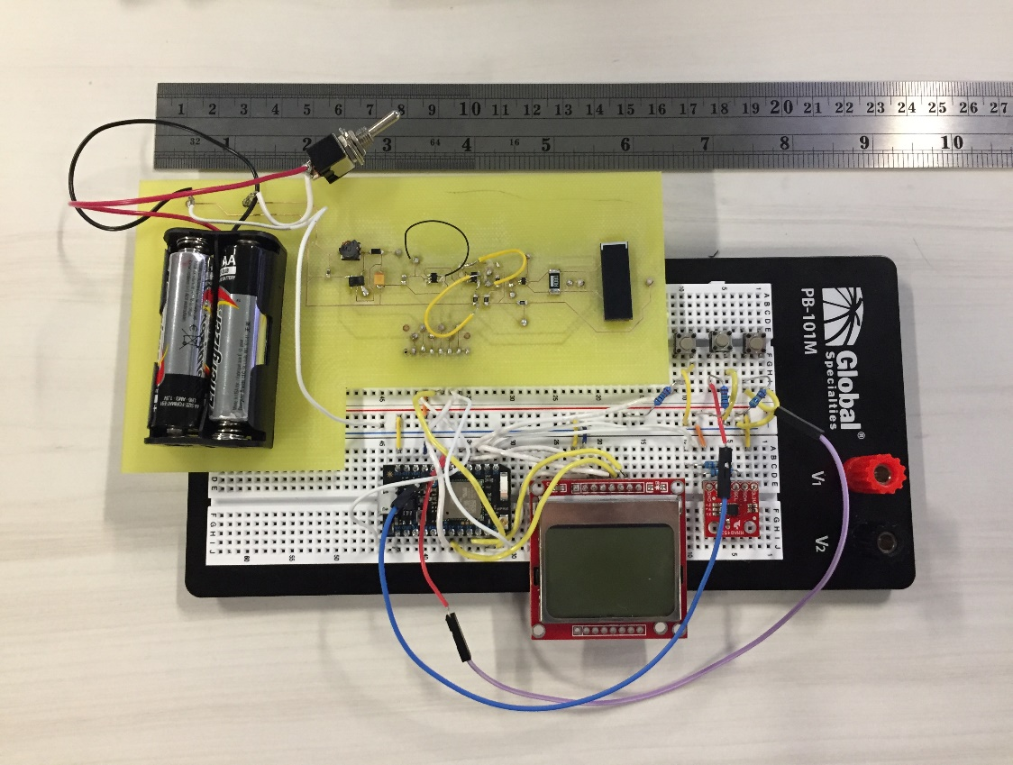
First Design
Solar Cell
Temperature Sensor
Microcontroller
LCD
Inclinometer
3

Slide 4
Results
4

Slide 5
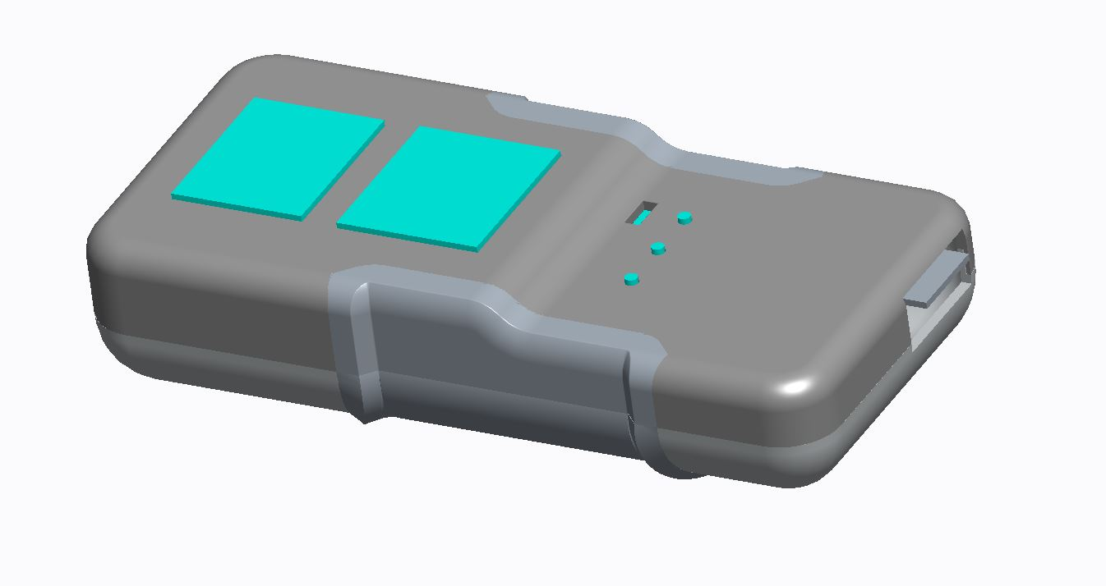
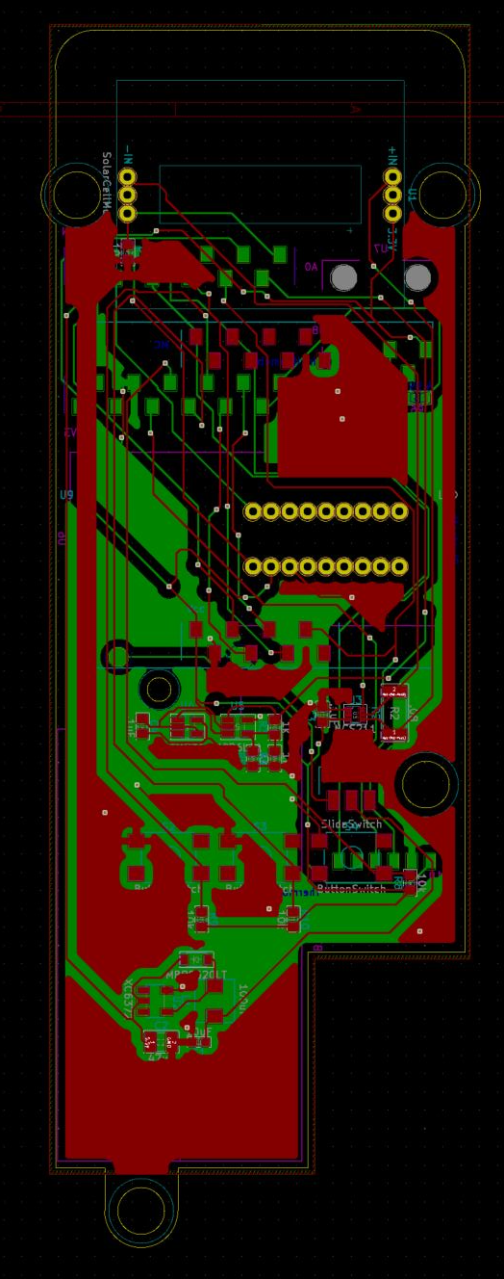
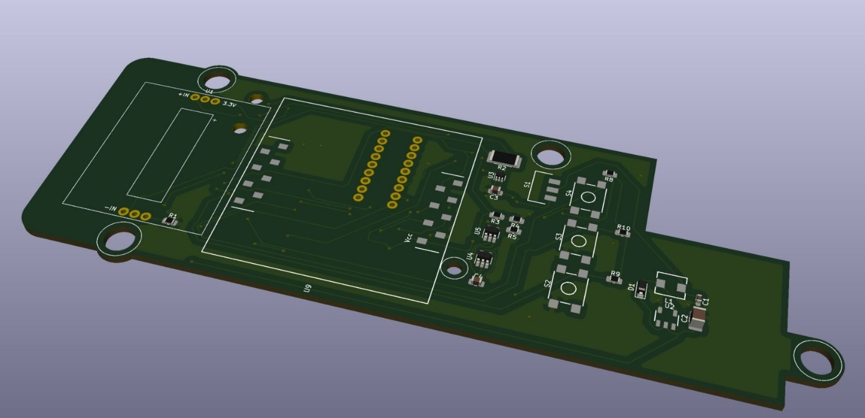
Model 2
LDC
Buttons
Solar Cell
Bluetooth
Thermocouple
Mounting Holes
5

Slide 6
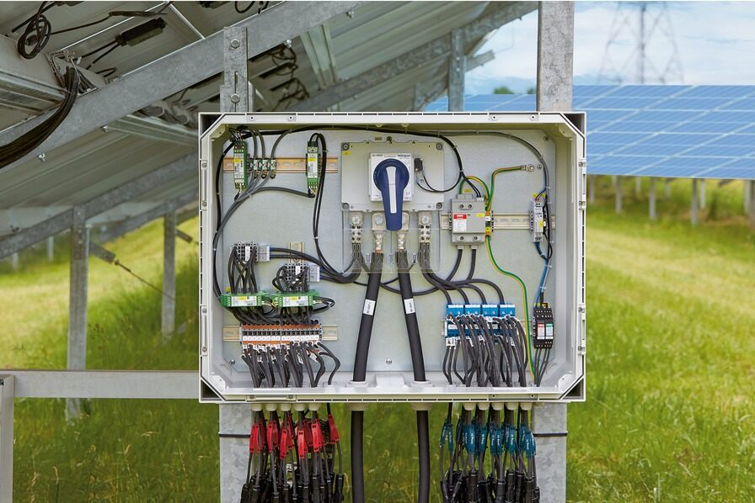
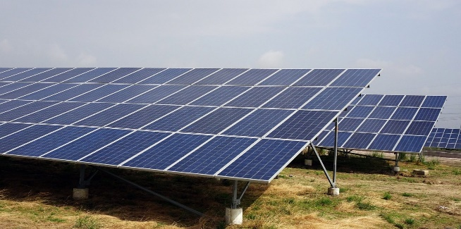
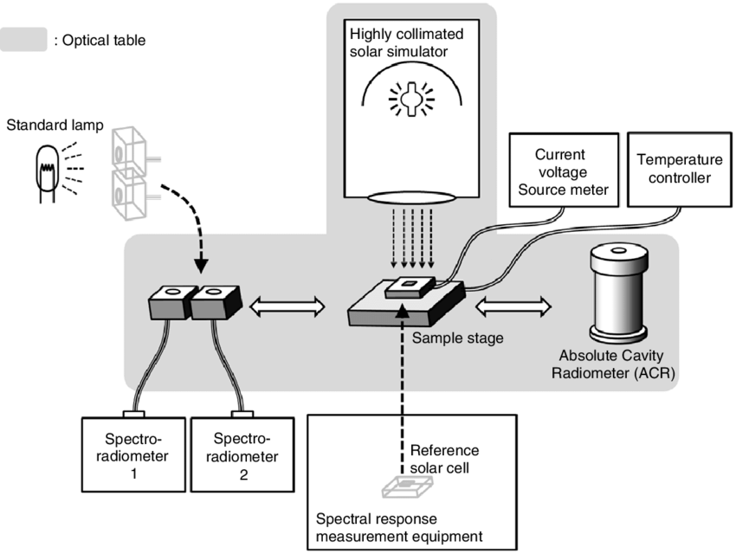
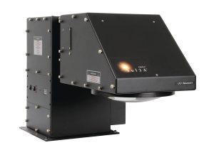
Additional Tasks
DC Combiner Box Research
Solar Panel Research
Calibration Techniques
Solar Simulator Research
6

Slide 7
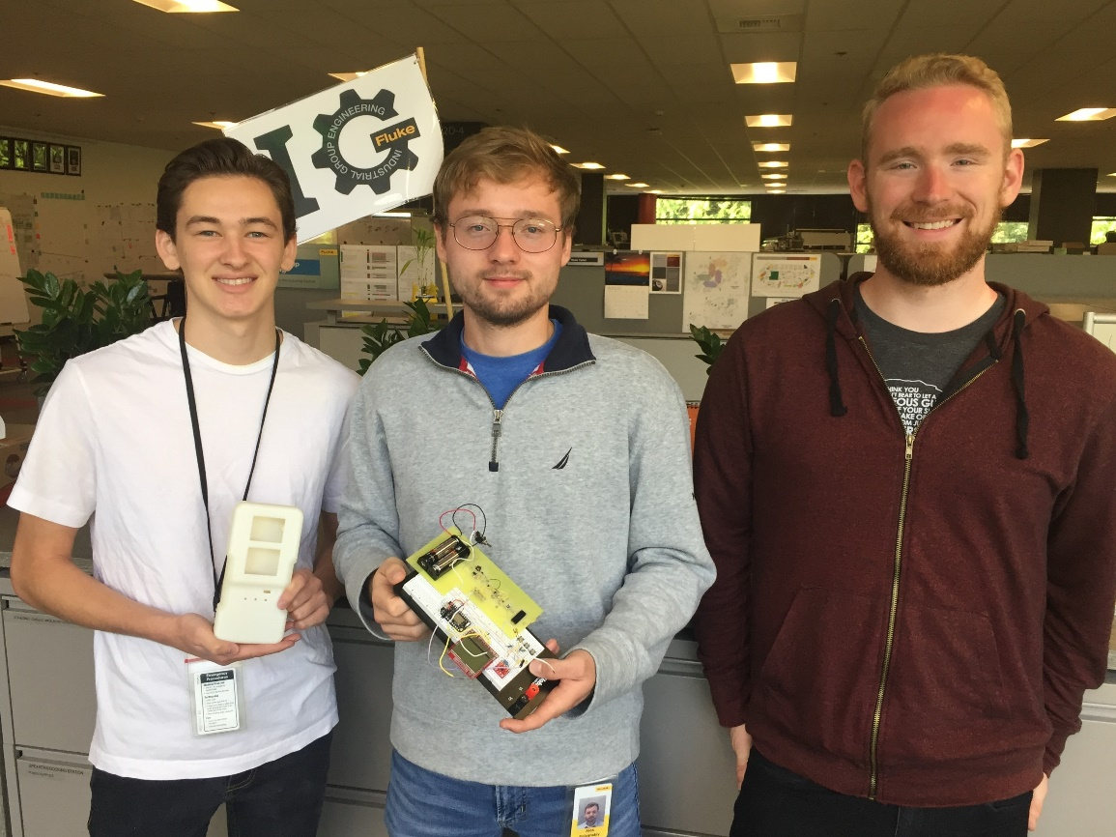
Internship Take-aways
Design Review, what to consider, how to select parts
PCB Design
Error Analysis
Working with Computer Engineering and Mechanical Engineering
Corporate Environment
Meetings
7

Slide 8
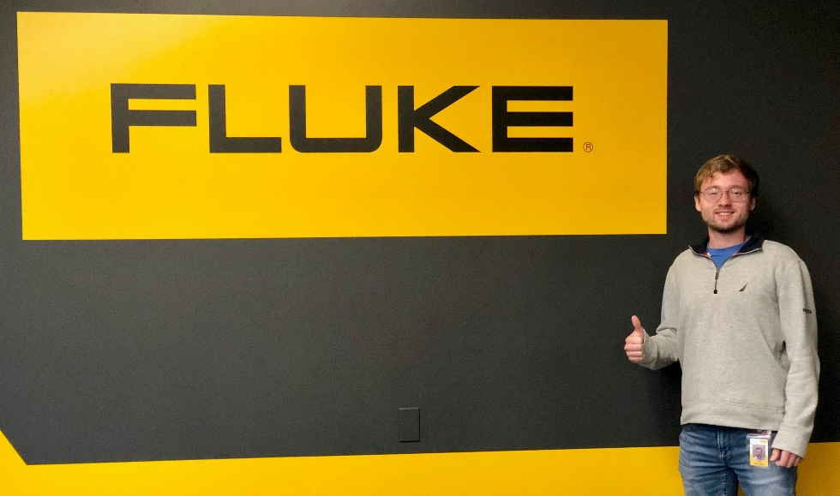
Feedback
Positive
Great coffee machine
Great experience with a project (from nothing to a final product)
Everyone will take time and help
Freedom
Multidisciplinary
Feedback from Josh and Paul
Improvement
Intern events at the beginning of internship
8

